Slide 1
Modernisation solutions for Rockwell Automation users
A phased migration strategy to optimise the update of your aging equipment
Notes:
Welcome the Webinar on modernization solutions for Rockwell users.

Slide 2
Agenda
Introduction to ProSoft Technology
  Other available webinars
Upgrade or modernize - What does it mean to you?
The problem and how to solve it
Phased migration approach
  Examples
Other solutions
  Legacy serial protocols
  Competitive PLC
  DCS migration
Summary

Slide 3

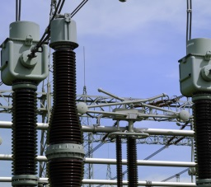
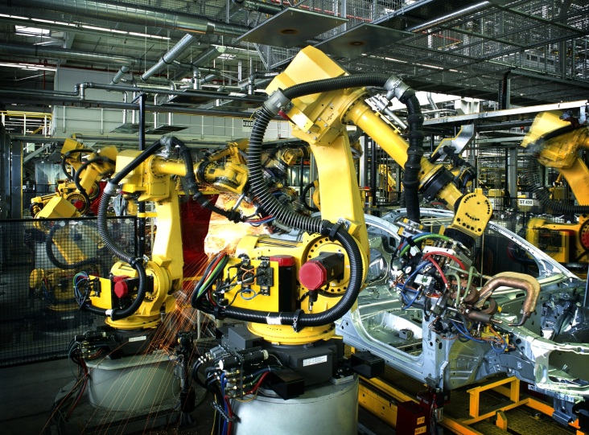
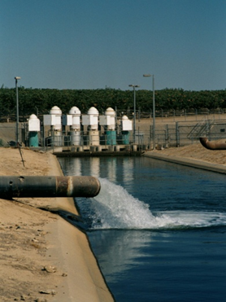
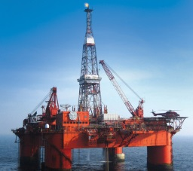
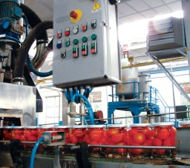



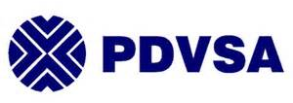
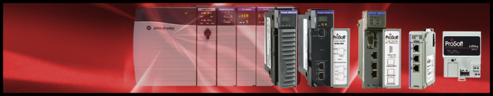





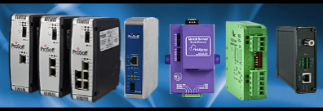




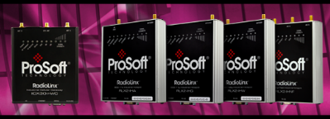



ProSoft Technology At A Glance
Purpose-built mission-critical networking systems that provide the highest confidence of reliability, availability and security
Key Vertical Markets
Discrete
Process
Energy
Comprehensive Industrial Infrastructure
Representative Customers
Plug-In Solutions for Partners
Industrial Gateway Solutions
Industrial Wireless Solutions
Notes:
25+ years
Industrial communication solutions for major automation vendors; In-chassis modules for Rockwell Automation & Schneider Electric as well as stand alone gateways and wireless solutions
We have several well known Global customers in key vertical markets.

Slide 4
ProSoft Technology – Who We Are
Application Experts
ProSoft really knows industrial communications applications
COMM - Connect, Optimize, Modernize, and Migrate
Customer Oriented
We are relentless in solving our customers’ challenges
Industrial customers trust ProSoft
Great Partner
Partnerships are integral to our business
We make our partners more successful
ProSoft Technology, with our partners,
optimize industrial productivity
with innovative communication solutions
Notes:
The strategic vision articulated four years ago remains the same – ProSoft and our partners optimize productivity with innovative communication solutions
Strategic visions should remain consistent over time, even as the plans we make to achieve them change and adapt to real world conditions

Slide 5
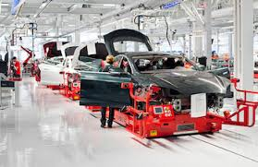
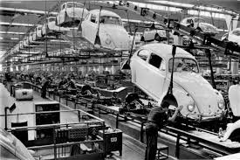

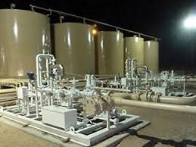
Available presentations
Automated Material Handling
Modernization
Remote Connectivity
Integrated Flow Computing
Notes:
This is one of a series of webinars that we will hold including:
Remote connectivity – a cloud based secure remote access solutions for the IIoT age
Integrated Flow computing for Rockwell Automation PACs
Wireless solutions optimized for Automated Materials handling applications such as AGVs, cranes, ASRS, warehousing, etc.
And modernization that I will cover today and will be available for download

Slide 6
Upgrade or modernize
Upgrade: Focus on a specific machine or line to address outdated technology. Usually a smaller investment that provides a one-for-one replacement of aging products for a modern versions.
Modernization: Applying contemporary technology to address obsolescence, improve productivity and setting the foundation to meet both current and future business objectives. Typically a larger investment with a higher return over time.
Notes:
Before I begin it is worth looking at the difference between upgrading and modernizing
Upgrading can be achieved in the short term, with a smaller investment from an operational expenditure budget
Whereas modernizing requires a larger investment, a long term vision and capital expenditure.

Slide 7
Is Modernization Right for You, Right Now?
If you’re contemplating whether to upgrade or modernize, ask:
Are we able to meet continuously changing consumer demand? (Modernize)
Do we need to cut operating costs, improve productivity or reduce downtime? (Modernize)
Do we need to have end-to-end visibility of our operations to be more responsive? (Modernize)
Do we want to access to data to identify process improvement opportunities? (Modernize)
Is our manufacturing systems able to meet the challenges of modern manufacturing? (Modernize)
Do we need to migrate from a discontinued product to reduce risk? (Upgrade)
Notes:
A significant number of manufacturing plants are more than 20 years old, with legacy automation systems reaching predicted end-of-life.
Are you one of those plants?

Slide 8
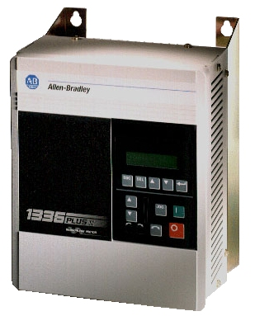
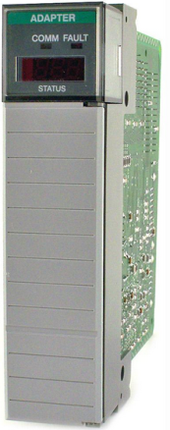
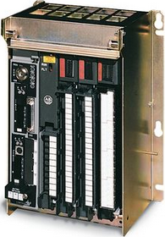
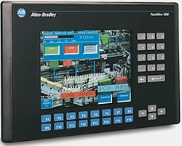
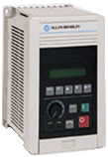
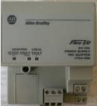


Problem
Huge install base of Allen Bradley Remote I/O Systems
Most of the products pictured above are either Silver Series or Discontinued
Notes:
The problem is that most plants have been operation for a long time, possibly over 10 years, and many of the assets in use today have become discontinued or near the end of life. This will cause the end user problems leading to down time and production stoppages.

Slide 9


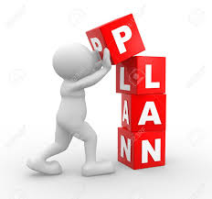
How to solve the problem?
Notes:
Collect: Inspect the application, machine, line or plant through an installed base evaluation (IBE), which is a cost effective way to identify obsolesce risks.
Analyse: Determine where you can make the biggest impact. Identify your most critical equipment, biggest risks and options
Plan: Define your scope based the application requirements, opportunities for productivity improvements, schedule, budget and ROI based on long-term business objectives.

Slide 10
Traditional Control system Upgrade
Install new Ethernet network infrastructure
  Cat 5 cables, Managed Switched, Fiber Optics
  Pull through existing cable trays or new Conduit
Convert programs
  PLC5 or SLC
  Drives
  PanelViews
Schedule enough downtime to upgrade entire system
Rewire and commission new system
  Debug wiring, PLC code, Drive Config and PanelView Config
Notes:
A traditional “rip out and replace” strategy could be more complex and potentially more labour and cost intensive; using the CAPEX budget I mentioned earlier.
But what if there was another way to improve productivity and reduce costs, whilst minimizing downtime? What if there was another way to replace a legacy network and introduce a modern Ethernet infrastructure for todays manufacturing but keeping the plant running?

Slide 11
Phased migration approach
A new EtherNet/IP based system can be introduced with the existing DH+ or RIO networks assets in a phased manner.
Legacy assets can be migrated one node at a time in a scheduled downtime saving time and money.
Once a legacy asset has been updated it can be used elsewhere in the plant as a spare minimizing downtime.
During commissioning if something goes wrong, you can put the legacy asset back in place.
Notes:
What this means for the Controls Engineer is that they can be
• Reactive - Replace equipment as it breaks
• Proactive – Replace legacy equipment as it fits in their maintenance budget
• Can manage spares more effectively
• Relatively quick option to keep the plant up and running in the event of an emergency
• Doesn’t necessarily require contracting a system integrator
• Doesn’t have to touch the Controller code that he likely doesn’t understand because it was done by someone else and it works
For Senior Management they can now can keep their plant up and running with minimal investment. Minimise downtime costs and loss in production. Senior management can now realise their long term plans for increasing efficiency

Slide 12
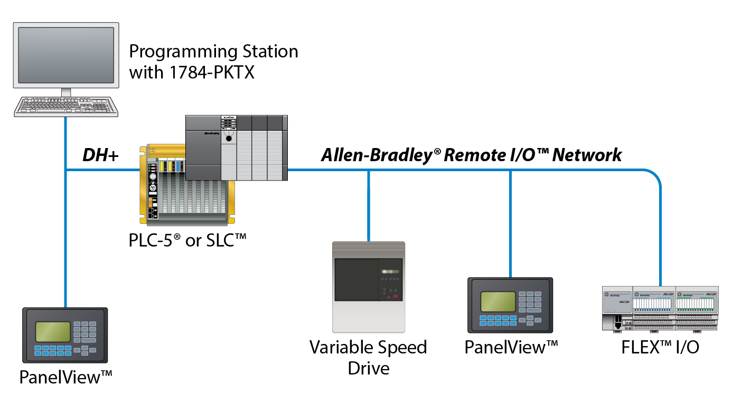
Existing plant
Notes:
In this example the existing plant is using older PLC5/SLC on DH+ and assets, such as drives, HMI screesn and FlexIO are on RIO

Slide 13
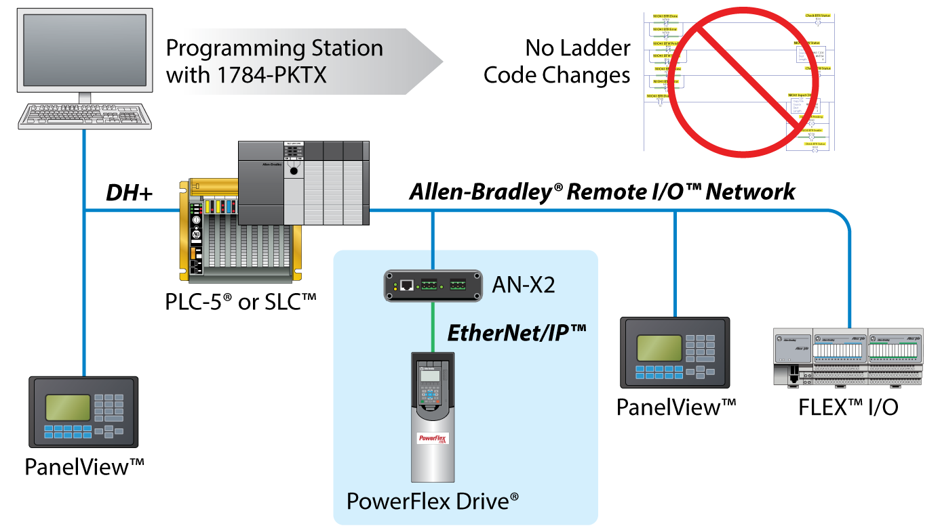
Need to replace your Drives?
Notes:
With a phased modernization approach you can change the drives to modern PowerFlex drives on EtherNet/IP without changing the main controllers code.

Slide 14
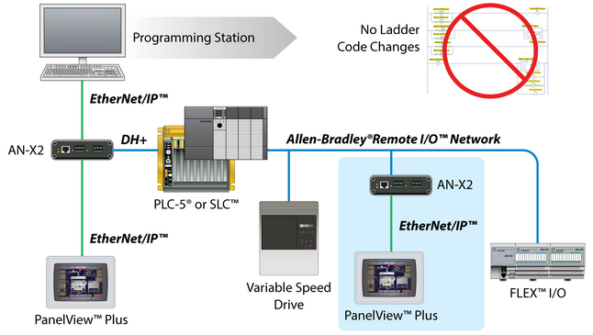
Are your PanelView™ Terminals or Programming Stations ready for an upgrade?
Notes:
With our modernisation solutions you can upgrade your Remote I/O and Data Highway Plus PanelViews to new EtherNet/IP PanelView™ Plus terminals, with no changes to your PLC program.
All modern PCs don’t have ISA or PCI slots but all have Ethernet ports. Our solution replaces the need for a 1784-PKTX card and can be used to modernize programming stations or SCADA PCs.

Slide 15
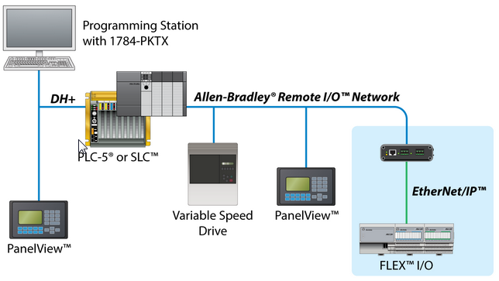
Running out of spare FLEX™ I/O Adapters?
Notes:
With our modernization solutions you can upgrade your Remote I/O adapters for FLEX I/O to new EtherNet/IP adapters without changing the code; freeing up spares.

Slide 16
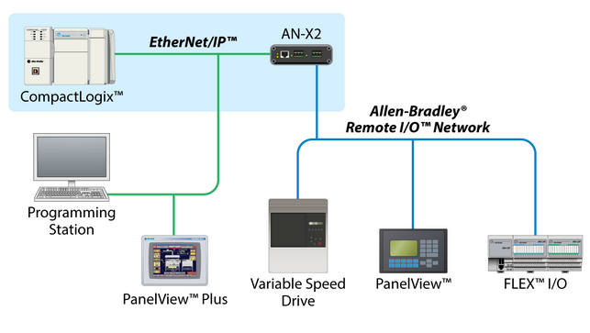
Want to upgrade your PLC-5® or SLC™ to CompactLogix™?
Notes:
Your site standard may be CompactLogix and NOT ControlLogix. Your CompactLogix can control your existing Remote I/O devices using our modernization gateway.
You can modernize to an EtherNet/IP network, changing programming stations, SCADA and HMI screens and still control your existing Remote IO network

Slide 17
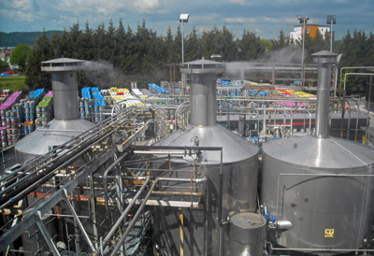
Application reference – Food & Bev
Overwiew
ProSoft Technology’s Partner | IAC
Customer | S.A. Brains & Co.
Location | Cardiff, Wales.
Application description | Brewery application. To update a 27 year old PLC2 to a modern CompactLogix.
Customer needs | Upgrade aging PLC2 to site standard – CompactLogix PLC on EtherNet/IP. Limit upgrade downtime to 3 days. Retain existing IO racks. Add modern SCADA system.
Notes:
Which is what they did at Brains Brewery in Cardiff, Wales

Slide 18
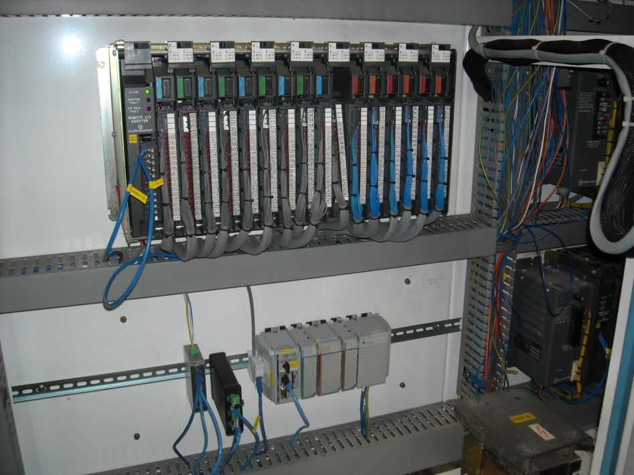
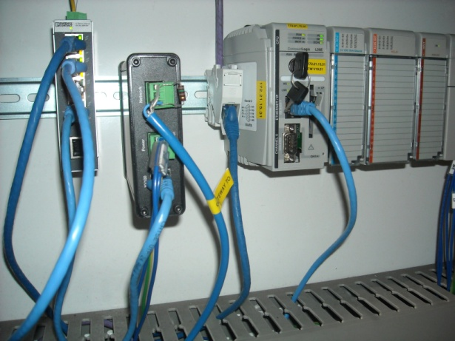
Application reference – Food & Bev
ProSoft Technology Solution
Our solution | AN-X2-AB-DHRIO gateway. Migrate existing 1771 IO to CompactLogix on EtherNet/IP.
Customer benefits | Reduced commissioning –No change to field wiring. Kept to site standard – no additional spares need to be held. IO data on EtherNet/IP can be accessed anywhere on plant network. 40% less than alternate solution.
Notes:
Before I move to the next stage of the webinar, I’ll pause for questions; (If no questions then)
Can I use the Flex IO solution with PointIO? No, the modernization gateway can only be used with FlexIO migrations only and NOT PointIO, SLC IO, 1771 IO but you can have 16 Ethernet/IP connections.
With the drives modernization, how many drives can I have on one gateway? You can have 4 drives with full rack addressing.

Slide 19
Legacy serial protocol modernisation
Overview
  Rockwell has removed the DF1 port from all of their new processors.
    Rockwell shipped processors with DF1 (serial) ports for more than 20 years
  As of July 2017 Rockwell discontinued their 1761-NET-ENI module
    Uploading and downloading between Ethernet and DF1
    Messaging between DF1 devices
Applications
  Many WWW facilities that were built using RA equipment, were built using the DF1 protocol
  Legacy network (DF1) slowly being discontinued by RA (similar to RIO)
  Water/Waste Water (WWW) networks are distributed over a large area through leased line modems
  Primary function of the module is DF1 Radio Modem with Store and Forward
Notes:
In your plant or facility you may be using legacy serial protocols, such as DF-1, for communications for HMI screens or for communications between sites using serial modems. These legacy protocols are being phased out but we have a range of solutions to modernise these networks

Slide 20
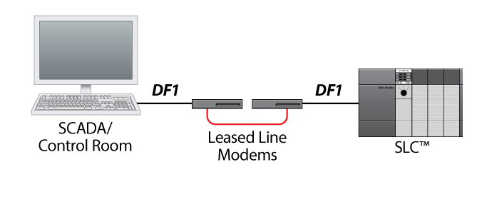
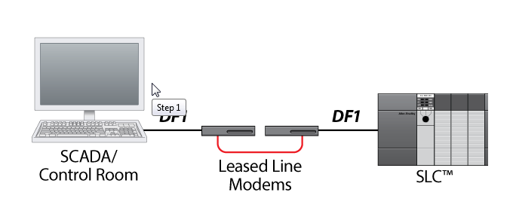
Existing network
Notes:
For example you may have an SLC5/03 or 5/04 using DF-1 on a remote network and you need to modernise the infrastructure whilst minimizing downtime.

Slide 21
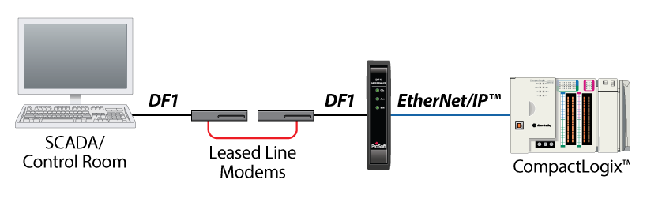
Step 1
Upgrade remote RTU’s by using a DF1 gateway
Notes:
Step 1. Upgrade remote RTU’s to modern logix PLCs (without serial ports) by using our DF1 gateway

Slide 22
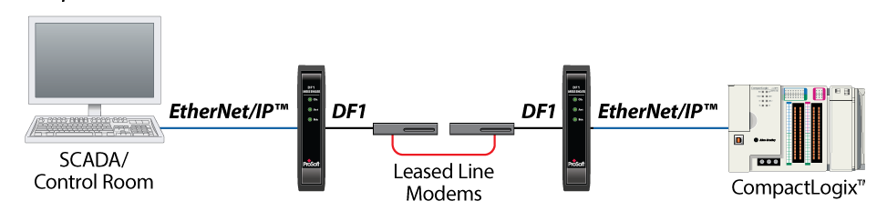
Step 2
Upgrade main SCADA to EtherNet/IP
Add gateway to SCADA location and re-use existing network infrastructure
Notes:
Step 2. Upgrade the main SCADA system to EtherNet/IP, whilst still using the existing network infrastructure

Slide 23
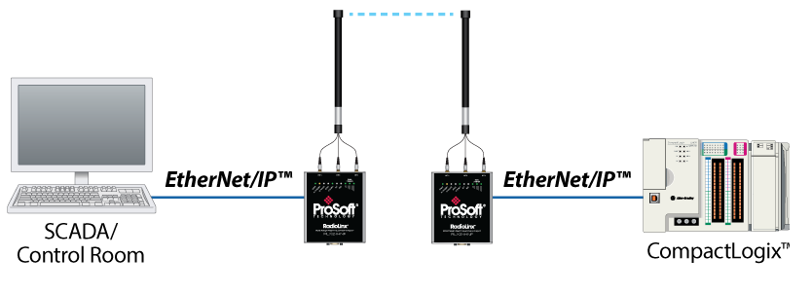
Step 3
Start replacing leased line modems with Wi-Fi radios or 4G cellular gateways
Notes:
Step 3. Replace the leased telephone lines to license free WiFi radios or the latest 4G cellular gateways. You have now modernized the legacy infrastructure to EtherNet/IP

Slide 24
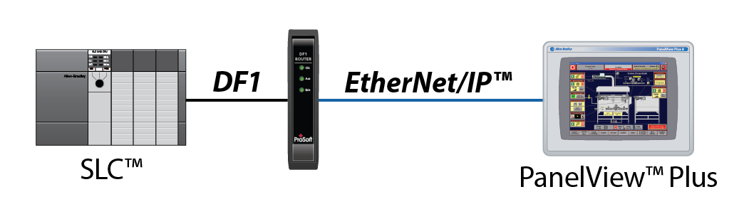
Application example
Upgrade legacy DF1 PanelView terminals to newer PanelView Plus terminals (similar to the AN-X2 with DH+ and RIO)
  PLX51-DF1-ENI only
Notes:
Other application examples include modernizing HMI panels but keeping the existing PLC

Slide 25
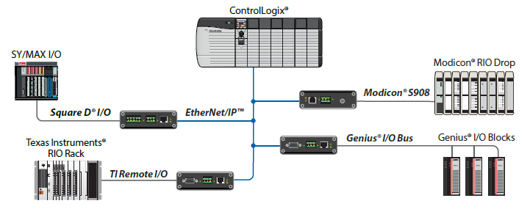
Legacy competitive PLC Modernization
Enables Rockwell Automation PAC via EtherNet/IP™ to control I/O devices on legacy networks
Monitor mode enables testing & verification of PAC logic before controlling I/O
Non-CE marked
Notes:
I’ll finish by briefly talking about modernizing legacy competitive PLCs and DCS systems

Slide 26
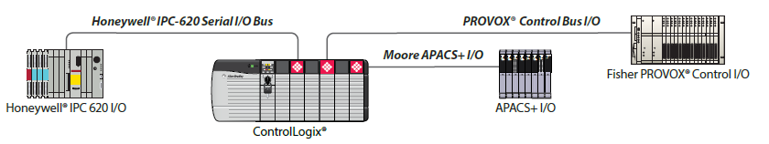
DCS Migration
Upgrade to Rockwell Automation’s PlantPAx DCS while using the existing legacy IO
Notes:
With this solution you can add a PlantPAx system to the existing DCS system in monitor mode, while you verify the code etc. When you are ready you can then switch the in-chassis card to “controller” mode, remove the DCS controller and use the legacy IO. If something goes wrong you can put the DCS controller back, while you debug the system

Slide 27
Summary
Solutions to upgrade or modernise
Solutions for the obsolescence problem
  Phased migration or “rip or replace”
Solutions for legacy protocol modernization
Solutions for competitive PLC or DCS modernisation
Which strategy you choose ProSoft Technology have the application experience to advise you to plan your modernization strategy to fit your budget.
Notes:
To recap ProSoft have :

Slide 28

Questions?
Notes:
Questions;
Can the DF1 solution be used as a 1761-NET-ENI replacement module? Yes, it can be used for uploading and downloading, supports panel views and DF-1 modems.

Slide 29
Your contact
Myles Heinekey
Regional Sales Manager + 44 7415 864902
Northern Europe mheinekey@prosoft-technology.com
ProSoft Technology - Manchester
Manchester International Office Centre, Suite 13, Styal Road,
M22 5WB
UNITED KINGDOM
www.prosoft-technology.com

