Slide 1
Improving Site Security Through Authentication
Ian Bayly & Paul Miller
Americas - EMEA

Slide 2
Company History
Over 20 years global leadership
World leading manufacturer of proximity and contactless card readers
A subsidiary of Roper Technologies (NYSE: ROP) Market Cap 26.55B$ (Nov 2017)
Chicago headquarters with global team and channel partners across 40 countries
Patented technology powers our readers, allowing configurability to nearly any proximity or contactless card technology in use worldwide
An ISO 9001 certified company
Notes:
20 years..
Timeline you can read at your leasure but the key dates was when we joined the Encompass program. Initialy in the US in 2012. EMEA came on stream in 16 and next year we join in APAC so there is a long history with 1000's of deployments worldwide
Our got to market is through distribution and Windmill have been our partners for over 15 years and know the products intimately which is why they are supporting your sales efforts in the background. All leads and enquiries are channel straight back into Routeco and we sit behind supporting where needed.

Slide 3
Market Trends
Company credential continues to be widely used
Trending towards more secure 13.56 MHz contactless solutions
Security/Chief Security Officer (CSO) responsibility sits at board level
Existing credentials meet IT management directives:
Reduce technologies, leverage existing card infrastructure
Leverage existing Active Directory systems
Improve identity management process
CISO driving greater compliance & audit
Lockdown ’Data protection’
General Data Protection Regulation (GDPR)
Health Insurance Portability and Accountability Act (HIPAA)

Slide 4
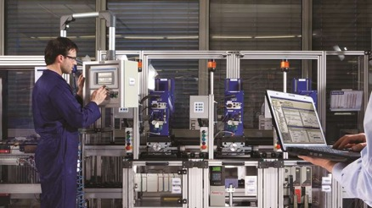
Badge Readers Increase Productivity & Security
‘RF IDeas badge readers installed at critical points throughout your facility, enables employees throughout the manufacturing facility to use their ID badge for secure logical access or single sign-on to production lines, industrial vending machines, factory workstations, compliance training sign-in and more’

Slide 5
RF IDeas Products Partner with Rockwell
‘The pcProx® Plus family of readers are built to work with Rockwell Automation HMIs, PACs and PLCs including FactoryTalk™ View SE and ME to streamline the log-in process. And it is easy to spec our readers in Rockwell systems, making it simple to find the right products to match Rockwell Equipment’

Slide 6
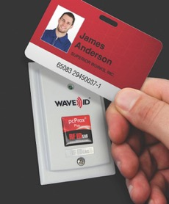
Operator Identification / Authentication
Identify operators during production
Limit equipment access
Set authorizations layers
Associate operator ID
SKUs, processes, operations management
Reporting
Who is on a machine?
What did they change?
Were they allowed to make changes?

Slide 7
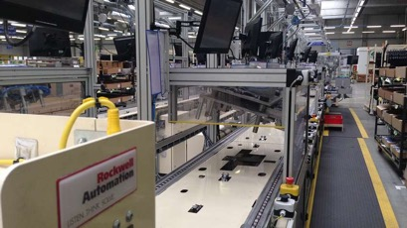
Factory Floor Challenges
Operator Identification / Authentication
Training Logging
Mustering Emergency Assembly
Quality Assurance
Time and Attendance
Industrial Supply Management

Slide 8
FactoryTalk® View Machine Edition (ME) Solution
FactoryTalk® View ME Solution
Keyboard wedge interface
No ActiveX Integration
Reader stores function commands as script
1-Factor Authentication
Username and Password
2-Factor Authentication
Username from badge
User enters the password or
User enters a PIN
Auto enroll new users from user Administration interface
Can also sync with PLC database
Notes:
Here is a demo video showing the login sequence on a PanelView operating a standard CE based application. Normally a userwould have to touch the screen and enter – User name, then password. Its slow and laborious and when we walk into sites generally see NO passwords, or simple ones like 999 being used, if limited to few employees by end of day every one know it.
Sometime see post it notes with PIN .... so no real security being used.
By deploying our readers it allows user to have their own unique ID and password.
How does the magic work ? The Reader auto sends a macro command to deposit the user name, applies a algorithm, creates hexidecimal password and logs you in.
To the workstation it’s effectively a keyboard wedge, there are no drivers to load, you plug it in and looks like a keyboard with someone typing very quickly. There is no additional programing to be done with standard Rockwell part numbers.
The configuration also allows your to set it up for 2 factor authentication, for instance user name and password and pause for a PIN and this is good practice on certain workstation which need greater control
In factory talk ME 8.1 and above there is the ability to do 'auto-enrollment'. In the past had to go into studio application to recompile and reload for each user which was not ideal.
You can sync up with PLC database ….. Using our Ethernet reader you would have a Allen Bradley PLC and set up look up table table with credential within the look up tableand the coding within the PLC would push the credential to the HMI panel to log you in…

Slide 9
Locking Unattended Workstations with
pcProx® Sonar
pcProx® Sonar
pcProx® Mat
Lock, Logoff
USB Plug-n-Play
Walk-up & Walk-away functions
Script capable
Notes:
In this video we are showing our presence detector called pcProxSonar installed on a HMI. This detects the user and can be configured to log them out when they leave the workstation. Its valuable on critical workstations and also ensures that a supervisor or managers login is not used by a operator after they leave. We have some customer who have Sonar installed on all workstations together with a reader.
You can adjust the angle and depth in the settings and even allow for someone to work to one side fpr some time without logging them out
We also offer a ruggedised Matt which does the same funtion when users step on and off.

Slide 10
FactoryTalk® View Site Edition (SE) Solution
FactoryTalk® View SE Solution
Keyboard wedge interface
No ActiveX integration
Reader stores function commands as script
1-Factor Authentication
Username and Password
2-Factor Authentication
Username from badge
User enters the password or
User enters a PIN
Can also sync with PLC Database
Can also use SDK reader with partner software
Notes:
Site edition running on full windows – could be local or server based.
Same reader part number as the ME version comes with a additional.HWG file so when you install the reader you load the .hwg file and its set to work on SE installations
Same functionality as ME version and can also sync with PLC database
Some of our worldwide partners use a SDK to develop some solutions, for instance that sync with active directory.

Slide 11
Allen-Bradley® Programmable Logic Controllers Solution
PLC/PAC Solution
ASCII output
No ActiveX integration
Creates instances
EDS file and sample code available
Support IEEE 802.3af 48vdc power sourcing devices
PoE interface
PoE injector
PoE switch
24VDC DIN rail to 48VDC PoE
Notes:
PLC integration is a little different
As apposed to keyboard wedge what outputs here is a ASCI file so we use a Ethernet interface and that is power by a injector, a switch or rack which you can see on slide
The way it works is by sending a ASCI output with header information.
The PLC is listening for information coming from specified IP address of our reader and inside PLC there are programs to capture that number, either do a look up and log onto workstation or perhaps start a process.
For instance the process to start the mixing of a batch of paint by pushing a button could be replaced with a reader instead saving time and ensure only authorised folks can start the process.
We have sample code available for these functions on our website

Slide 12
Industrial Thin Client - ThinManager®
ThinManager® supports RF IDeas pcProx® Readers
Delivered content based on TermSecure role
Supports relevance functionality
TermSecure users can use same badge
Can be linked to an Active Directory account
Supports multi-factor authentication
Supports FactoryTalk® View SE login
Supported Readers
RDR-6081AK2 pcProx Enroll HID Prox Black 5v PS/2 RS232 Reader
RDR-6081AKU pcProx Enroll HID Prox Black USB Reader
RDR-6011AKU pcProx Enroll HID Prox Black Vertical USB Nano Reader
RDR-80582AK0 pcProx Plus 82 Series Black USB Virtual COM Reader
RDR-80082AK0 pcProx Plus 82 Series w/ iCLASS ID Black USB Virtual COM Reader
Secure Access Secure Terminals
Readers added to all Rockwell new quotes
Notes:
We are supported out of the box in Thinanager and there is a drop down menu within our reader config tool to add it and support authentication or even multifactor authentication.
I understand Rockwell sales teams in Europe now quote our readers as part of all new ThinManager deployments so it becoming standardised

Slide 13
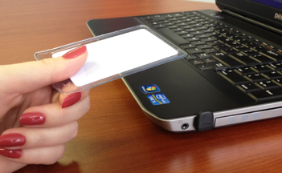
pcProx® Nano – World’s Smallest Reader
Plug-and-play operations
USB interface
Enables security, easy identification, simple access
125 kHz & 13.56 MHz
Dimensions
Vertical: Height 0.72” x Width 0.62” x Length 0.72”
Horizontal: Height 0.36" x Width 0.62" x Length 1.14"
13.56 MHz
Vertical
Horizontal
Notes:
Should this be in metric instead of inches?

Slide 14
Case Study: Recipe Paint Manufacturer
Added pcProx® Playback on manufacturing floor for PLC control for Operator ID and Asset ID
Operators scan into the PLC database before building scanning recipe components
Averaging 12 bad recipes per week before integration with RF IDeas product and at an average cost of $3800 per recipe.
Post RF IDeas deployment of 92 readers 1 bad recipe per week. ROI within 5.5 days.
Notes:
If being delivered in UK should you change from US dollars to UK?

Slide 15
Manufacturing – Semiconductor
Need two ID technicians accessing clean room
Wrist band tag under clean room suit
Worldwide deployment
HMI Integration
Single Sign On application
Training Integration

Slide 16
Manufacturing - Operator ID
Replaced 1000’s of magstripe readers on manufacturing floor with pcProx®
Deployed 12,000 readers for Single Sign On
HMI Integration
Leveraged existing infrastructure
Improved quality audit
Increased reliability
Quick return on investment

Slide 17
Rockwell Support Product Price List
PART NUMBER | DESCRIPTION | MINIMUM ORDER QUANTITY | Product Information
FOR HMI/PANELVIEW PLUS | FOR HMI/PANELVIEW PLUS
RDR-805W1AGU-RA | pcProx Plus Reader; Panel Mount; Gray; USB; Rockwell Automation | 1 | https://www.rfideas.com/industry/rockwell
KT-805W1AGU-RA-IP67 | pcProx Plus Reader; Panel Mount; Gray; USB; IP67; Rockwell Automation | 1 | https://www.rfideas.com/industry/rockwell
RDR-80081AKB-P | pcProx Plus Enroll w/ iCLASS ID Black EtherNet/IP POE Reader | 1 | https://www.rfideas.com/industry/rockwell
RDR-805W1AKU-RA | pcProx Plus Reader; Panel Mount; Black; USB; Rockwell Automation | 1 | https://www.rfideas.com/industry/rockwell
KT-805W1AKU-RA-IP67 | pcProx Plus Reader; Panel Mount; Black; USB; IP67; Rockwell Automation | 1 | https://www.rfideas.com/industry/rockwell
RDR-800W1AKE-P | pcProx Plus Enroll w/ iCLASS ID Surface Mount Black Ethernet POE Reader | 1 | https://www.rfideas.com/industry/rockwell
RDR-80581AKU-RA | pcProx Plus Reader; Desktop; Black; USB; Rockwell Automation | 1 | https://www.rfideas.com/industry/rockwell
KT-IP67 | IP67 Kit for Panel Mount Reader | 1 | https://www.rfideas.com/industry/rockwell
BSE-PCPRX-SNR | pcProx Sonar USB Presense Detector | 1 | https://www.rfideas.com/products/presence-detectors/pcprox-sonar
MAT-FR1924AKU | pcProxMat Fine Ribbed 19" X 24"Black USB Presence Detector | 1 | https://www.rfideas.com/files/rfideas/files/support/doc/data-sheets/pcProxMat.pdf
FOR PLC's | FOR PLC's
RDR-805W1AKB-P | Panel Mount; Ethernet Industrial Protocol; Black | 1 | https://www.rfideas.com/industry/rockwell
KT-805W1AKB-P-IP67 | Panel Mount; Ethernet Industrial Protocol; Black; IP67 Rated | 1 | https://www.rfideas.com/industry/rockwell
RDR-80581AKB-P | Desktop; Ethernet Industrial Protocol; Black |  | https://www.rfideas.com/industry/rockwell
FOR THINMANAGER | FOR THINMANAGER
RDR-6081AK2 | pcProx Enroll HID Prox Black 5v PS/2 RS232 Reader | 1 | http://www.thinmanager.com/kb/index.php/Card_Readers
RDR-6081AKU | pcProx Enroll HID Prox Black USB Reader | 1 | http://www.thinmanager.com/kb/index.php/Card_Readers
RDR-6011AKU | pcProx Enroll HID Prox Black Vertical USB Nano Reader | 1 | http://www.thinmanager.com/kb/index.php/Card_Readers
RDR-80582AK0 | pcProx Plus 82 Series Black USB Virtual COM Reader | 1 | http://www.thinmanager.com/kb/index.php/Card_Readers
RDR-80082AK0 | pcProx Plus 82 Series w/ iCLASS ID Black USB Virtual COM Reader | 1 | http://www.thinmanager.com/kb/index.php/Card_Readers
CREDENTIALS
BDG-2000 | HID™ iCLASS™ Contactless ( ISO ) | 100 | https://www.rfideas.com/products/credentials
BDG-2080 | HID iCLASS Clamshell 2k/2 Card 2080PGSMV H10301 FC 228 | 100 | https://www.rfideas.com/products/credentials
BDG-CTW-MIFARE-1K | MIFARE 1K 30mil White Adhesive Tag | 100 | https://www.rfideas.com/products/credentials
BDG-FOB-MIFARE-1K | MIFARE 1K Keyfob Blue | 100 | https://www.rfideas.com/products/credentials
BDG-ISO-MIFARE-1K | MIFARE 1K ISO 30mil Card | 100 | https://www.rfideas.com/products/credentials
BDG-ISO-MIFARE-1K-V | MIFARE 1K ISO 30mil Card w/Vertical slot punch | 100 | https://www.rfideas.com/products/credentials
BDG-WRIST-M-1K | MIFARE 1K Wristband Black | 100 | https://www.rfideas.com/products/credentials
BDG-WRIST-EM-N | EM Wristband Nylon Strap Black | 100 | https://www.rfideas.com/products/credentials
BDG-FPISO | Indala FlexISO 30mil Card 26 bit FC 75 | 100 | https://www.rfideas.com/products/credentials

Slide 18
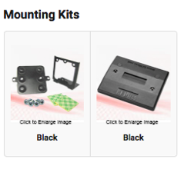
Resources - https://www.rfideas.com/industry/rockwell
RESOURCES
EIP Setup Manual pcProx Plus AKB-P EDS File Compact Logix PLC Sample Code Rockwell HOTT Training Guide Rockwell Application Brief Application Brief Manufacturing Interactive Manufacturing Facility Rockwell Knowledge Base
FactoryTalk View ME Quick Start Guide FactoryTalk View SE QuickStart Guide & Files

Slide 19
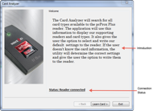
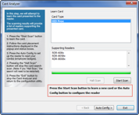
How Do I Identify Customers Credentials?
pcProx® Plus includes a built in card analyser
Identifies virtually all worldwide credential types
Use RF IDeas pcProx Plus Reader Analyser onsite to identify the customer credential (RDR-80581AKU & RDR-80081AKU)
Software Based
LEARN: determine the badge (card) technology used and instantly display all compatible RF IDeas readers for that badge (card) type.
CONFIGURE: with a click of a button, the reader is easily configured.
ANALYZE: analyzes the badge data (ID, FAC, bits, etc.) when more information is needed
Credentials Available For Order
Note he Beveled edge
Clamshell
ISO 30mil
Stickers
Key fobs and Tags
Major Credential Manufactures
ISO15693
ISO 14443A
Routeco Live 2018

Slide 20
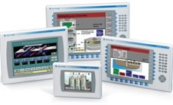
pcProx® Plus Reader Options
Easily integrated with Rockwell products
Out of the box configured to work with PanelView Plus terminals & programmable controllers
Combines proximity and contactless capable of reading both 125 kHz proximity cards and 13.56 MHz
USB Interface
Keystroking Macros
Ethernet PoE
ASCII Output
RDR-80xx1AKB-P readers support standard IEEE 802.3af 48vdc power sourcing devices
PoE Injector, PoE Switch, 24VDC DIN Rail to 48VDC PoE
Versatile Mounting Options
Desktop or Surface Mount
IP 67 Surface Mount
Compatible with Windows CE / 7 / 10 / Linux

Slide 21
Key Takeaways
All RF IDeas products are easy to install, easy to operate, configurable, and part of the Rockwell Encompass program
Americas - EMEA
Features
Pre-configured –plug & play
Automatic identification and authentication
Variety of models (USB, Ethernet/IP)
Reads nearly all proximity/contactless cards
Benefits
Faster employee logon/logoff
Record & track production
Meet regulatory / government requirements
Reduce errors / waste
User accountability

Slide 22
Thank You!

Slide 23
BACKUP

Slide 24
Training Logging
Manual Process
Illegible writing results in entry errors
Timeliness of recording
Outliers
Badge Based Automated Process
Eliminate transcription errors
Instant record update
Know who is missing immediately
Tie to login process

Slide 25
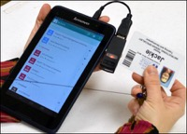
Mustering Emergency Assembly
Manual Process
Read names off list
No method to identify if someone is missing
Badge Based Automated Process
Tablet / smartphone based
Application immediately updates when badges are tapped on reader
Status of count automatically sent to other groups
Outliers are known in real time
Real time record of event and attendees

Slide 26
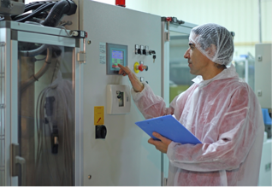
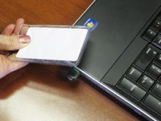
Quality Assurance
Manual Process
Transcription errors
Timeliness of recording
Outliers
Badge Based Automated Process
Eliminate transcription errors
Instant record update
Automatic logging of record
Less paperwork
Tie employees to SKU production

Slide 27
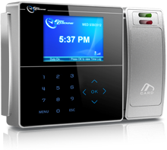
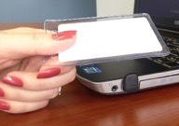
Time and Attendance
Manual Process
Transcription errors
Timeliness of recording
Remote Work Site Reporting Delay
Miss payroll
Badge Based Automated Process
Eliminate transcription errors
Instant record update
Confidence in paycheck accuracy
Compliance with employment laws
Less paperwork

Slide 28
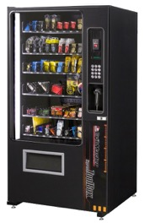
Industrial Supply Management
Manual Process
Paper based
Inventory is not controlled
Unaccounted for tools / supplies
Badge Based Automated Process
Inventory maintained in real time
Employee authorization levels capable
Keep track of tools and supplies
Compliance with government tool management requirements
Modular add on to existing units

Slide 29
Attendance Management
Using pcProx and internal software with traditional time clocks
Verification of attendance is automated
Simplified roll call and sign in
Department chargeback - medical credit monitoring

Slide 30
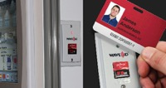
Applications & Partners
Applications
FactoryTalk® View ME/SE
Allen-Bradley® PLC/PAC
ThinManager®
SCADA
Industrial dispensing machines
Mobile devices
Payroll
Point of Sale
…and many more
Solution Partners
Distributors
System Integrators
OEM builders
Rockwell Automation
…and many more

